Slide 1
Parallax and Distance Between Stars

Slide 2

By the end of this lesson, you should be able to:
Explain the phenomenon of parallax.
Calculate the distance to far-away stars using parallax.

Slide 3
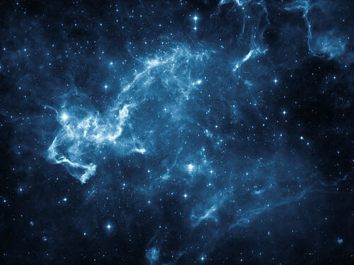
What Halley found was that the stars had moved relative to the stars around them.
Their positions were even noticeably different to those on Tycho Brahe's star charts, which were only made 150 years before Halley's.
This discovery was proof that some stars move.

Slide 4

To understand the implications of this discovery, first we should talk about parallax.
Close one eye, stick your thumb out in front of you and cover some point in the distance with it. Now switch your open eye.
The point you were looking at should have jumped out from behind your thumb as you changed eyes.

Slide 5
Of course, the point isn't actually moving - it's just you changing the place you are viewing from!
Observing something from different points will make it appear to move.
You can see this effect easily when you are in a car, for example. Trees and other objects close to the car will move a lot faster than buildings or mountains in the distance.

Slide 6
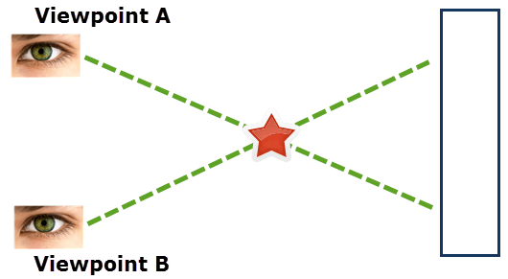


Parallax Example
Say you are looking at a Christmas ornament in front of a blue wall. If you look from viewpoint A, you see the star on the right side of the wall.
If you look from viewpoint B, you see it on the left side of the wall.

Slide 7
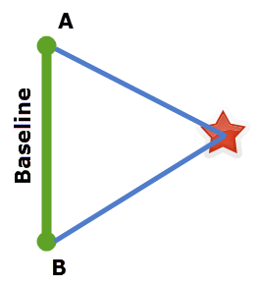
The line between two viewing points is called the baseline.
The baseline forms one side of a triangle, the other two sides being lines from the viewpoints to the object.

Slide 8
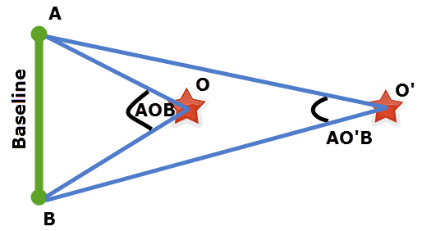
We have two objects, one further away from the baseline than the other, called O and O'.
The angle ∠AOB at the object O is larger than the angle ∠AO'B at object O'.
So a very far away object will have a very small angle. The smaller the angle is, the less it will appear to move as you travel along the baseline.
So how do we use parallax to measure the distant stars?

Slide 9
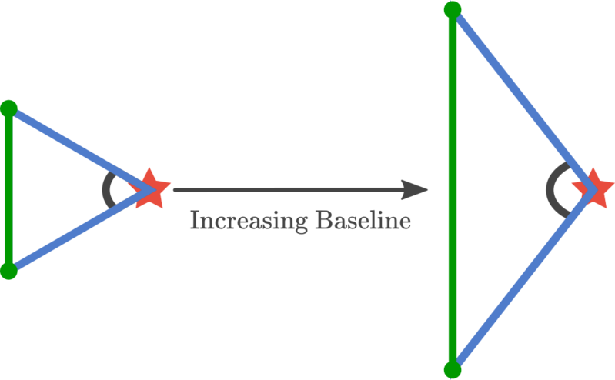
We can increase the angle by increasing the baseline!
So if we tried to measure to the stars, we could make a bigger baseline to get an accurate measurement.

Slide 10

Now, let's move back to Halley's observations.
Halley had seen that some stars had appeared to move relative to others.
So Halley's observations indicated that some stars, especially the brightest of stars, are closer to Earth than others. This is why they are bright - they are closer to us!

Slide 11
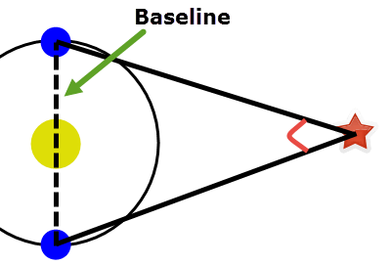
To accurately use parallax to measure the distance between the Earth and the stars, we need the largest baseline possible.
You might think that this would be the Earth's diameter, but there is one larger measurement that we can make.
That would be the diameter of Earth's orbit around the Sun.

Slide 12
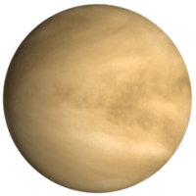
But now that introduces another problem: what is the diameter of Earth's orbit?
We can't use radar ranging to measure the distance to the Sun because the Sun produces too many signals for the returning signal to be detected.
What we do instead is measure the distance to Venus.

Slide 13
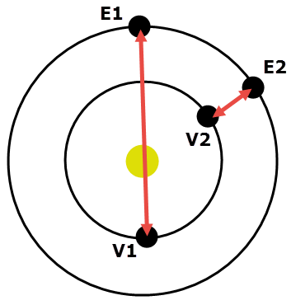
Both Earth's and Venus's orbits are circular and centred on the Sun.
So we can use the distance from Earth to Venus to calculate the diameter of our orbit.
First measure the distance to Venus when it is closest to Earth. Then measure the distance again when it is the furthest from Earth.
The sum of those distances is the diameter of Earth's orbit.

Slide 14
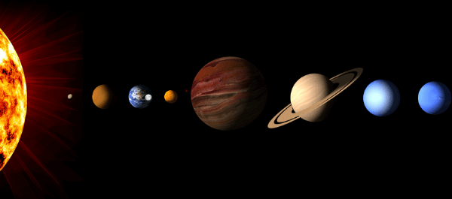
This trick gives us the Earth's orbit's diameter, which is around 300 million kilometres.
This means that our orbit's radius, the distance from Earth to the Sun, is 150 million kilometres.
The distance from the Sun to the Earth is so important that we have made it a unit - the astronomical unit (AU).
1 AU is equal to 150 million kilometres.

